Slide 1
Twine: creare un videogioco narrativo (senza saper progettare un videogioco)
Giulia Conti
Università degli studi di Modena e Reggio Emilia
29 January 2024

Slide 2
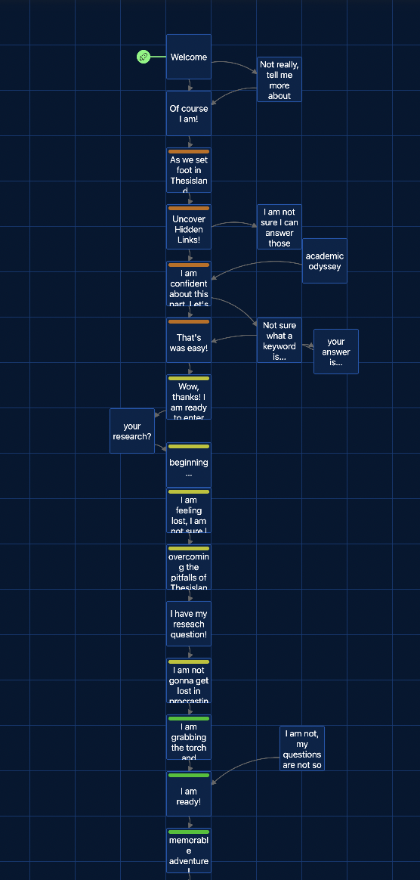
LEA - Learning in academia
In the video game, Lea is the narrator; she is the great-granddaughter of Galileo Galilei, the father of the scientific method.
Together with Lea, players explore the fantastical world of research, where each phase of the research corresponds to a unique environment.
For instance, "Wonder" is represented by a quarry, with an obvious nod to Plato's allegorical "Cave" readily apparent.

Slide 3
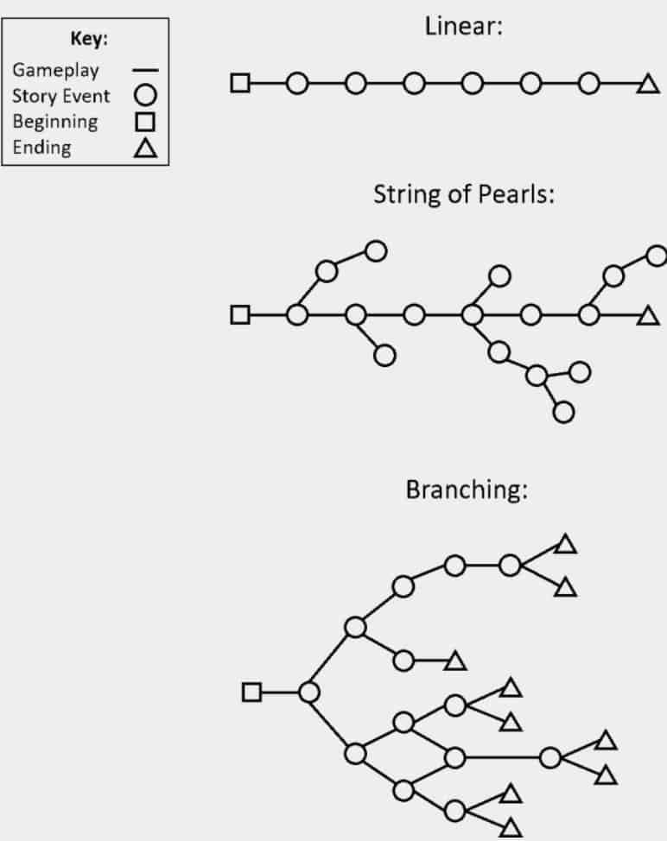
A linear narrative is a story progression that follows a very specific forward-motion set of events that doesn’t allow the player to back track, skip ahead or influence the storyline at all. Some popular games in this style include: Super Mario Bros, Sonic The Hedgehog, Prince of Persia.
The string of pearls narrative model is when game play has a general linear progression but can be influenced by the player. This style includes a level of interactivity that gives the player freedom to choose different missions or side quests. Some popular games include: Final Fantasy and Uncharted,
A branching narrative is a more complicated type of narrative which is central to the players choices. This narrative type allows the player to control the progression of the plot and changes the ending depending on their choices. An example is the popular PS4 (PlayStation 4) horror game, Until Dawn.
The amusement park model is similar to the branching model and is a common strategy for open world games. It allows the player to control the story through interaction but rather than completing missions or side quests, the player finds these branches through interacting with the NPC that is attached to that particular storyline. An example of this is the popular game series Assassin’s Creed and Skyrim.
Chris Stone, Gamasutra

Slide 4
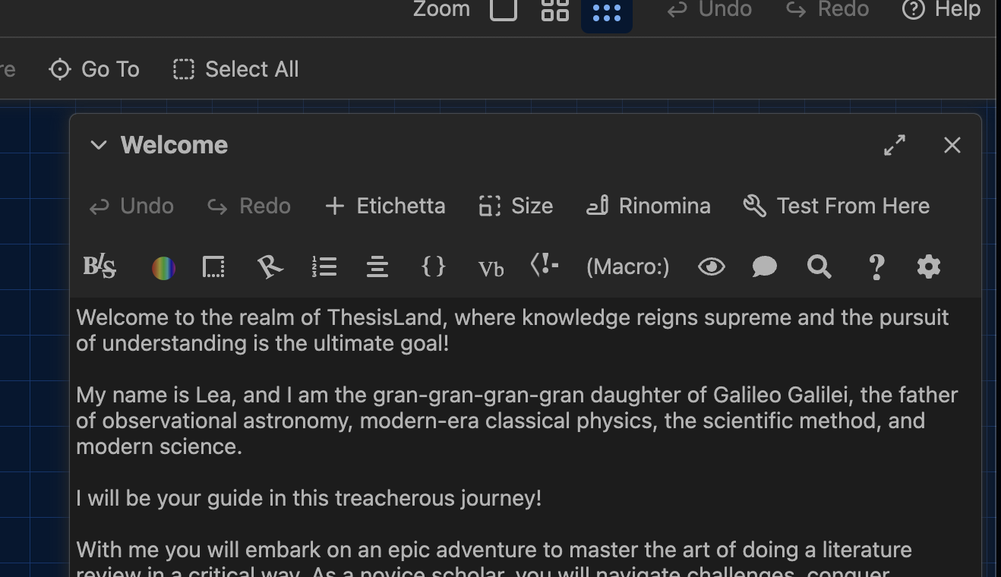

Slide 5
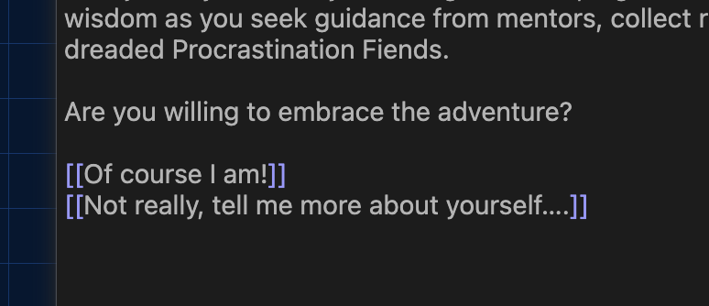
The double square brackets, before and after the words will be the link to click to progress the story.

Slide 6
https://twinery.org
a free online platform to create interactive, nonlinear stories.
Accessibility
Adaptability
Free tool
Open source
No download needed
No code needed
Easy to learn

Slide 7
Thank you!

