Slide 1
Dual-Skill Enhancement through Game-Based Learning: Bridging Soft and Hard Skills
Angelo Mirra (a.mirra@lumsastud.it)
PhD: Learning Sciences & Digital Technologies, Gaming
Silvia Dini (silvia.dini@unipr.it)
PhD: Learning Science & Digital Technologies, Technology enhanced learning
Multiplier event Progetto ERASMUS
Improving Transliteracy Skills through Serious Games (TLT4U)
Università di Parma, lunedì 29 gennaio 2024

Slide 2
What do we need to communicate?
Socio-pragmatic competences
Linguistic competences
Extra-linguistic abilities
IMPROVING TRANSLITERACY SKILLS THROUGH SERIOUS GAMES, 29 GENNAIO 2024
IMPROVING TRANSLITERACY SKILLS THROUGH SERIOUS GAMES, 29 GENNAIO 2024

Slide 3
HARD SKILLS - SECOND LANGUAGE ACQUISITION (SLA)
Radical shift from a lecture-based approach to a more collaborative, socially engaging and dynamic one. This shift has been supported by some theoretical foundation:
INTERACTIONIST APPROACHES (1998-99)= social interaction emerges as pivotal process for L2 learners to acquire linguistic data.
SOCIOCULTURAL THEORIES (Vigotsky, 1980)= human beings’ mental processes and their social activities are determined by one another.
BLENDING PARADIGM (Slater, 2002)– users benefit most from entertainment-education when they do not perceive the distinction between learning and playing.
Realistic interaction that creates Social Presence fundamental to incorporate teamwork and guarantee
ACTIVE LEARNING
IMPROVING TRANSLITERACY SKILLS THROUGH SERIOUS GAMES, 29 GENNAIO 2024
IMPROVING TRANSLITERACY SKILLS THROUGH SERIOUS GAMES, 29 GENNAIO

Slide 4
DIGITAL GAME-BASED LEARNING (DGBL)
Active engagement, enjoyment, teamwork, and co-construction of meaning
Integrate new vocabulary into real-life conversations
Can be used to monitor progresses
Place greater control of the learning processes in the hands of the student
Replicate real-life in a “sheltered” context (sandbox)
Student proficiency
CRUCIAL FACTORS
IN DGBL
Level of language difficulty
Game Design
Willingness to comunicate
IMPROVING TRANSLITERACY SKILLS THROUGH SERIOUS GAMES, 29 GENNAIO 2024

Slide 5
(Video)games as social and collaborative space
MASSIVELY MULTIPLAYER ONLINE ROLE PLAYING GAMES (MMORPGs)
“a persistent, networked, interactive, narrative environment in which players collaborate, strategize, plan, and interact with objects, resources, and other players within a multimodal environment” (Dickey, 2007).
Multimodal environment (texts, images, sounds, narratives) = complex semiotic learner experience.
«BEYOND-GAME» CULTURE (Ruy, 2011)= online communities where interaction is more active and richer than in-game interaction. Multicultural, multimodal and multilingual moments.
In-game and out-of-game learning environments are interrelated:
In-game interaction assists with the acquisition of English words and phrases
Beyond-game facilitates English discourse development
IMPROVING TRANSLITERACY SKILLS THROUGH SERIOUS GAMES, 29 GENNAIO 2024

Slide 6
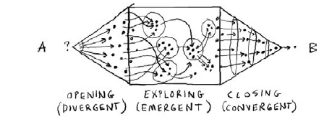
THE SOFT SKILLS «GAP»
Due to the increasing competitive system and high level of complexity, companies are focusing more on transversal skills (interacting efficiently with teammates and superiors, dealing with work-related disputes or difficult situations, being innovative and creative, being positive and willing to learn).
soft skills account for 85% of success in working environment (in Sutil-Martín & Otamendi, 2021)
Soft skills can be improved during L2 acquisition using videogames because they allow DISCUSSION and KNOWLEDGE-SHARING.
GAMESTORMING: suitable type of game for training soft skills.
3 stages:
- Opening (Divergent)
- Exploration (Emergent)
- Closing (Convergent)
IMPROVING TRANSLITERACY SKILLS THROUGH SERIOUS GAMES, 29 GENNAIO 2024
IMPROVING TRANSLITERACY SKILLS THROUGH SERIOUS GAMES, 29 GENNAIO 2024

Slide 7
VIDEO GAME DESIGN MODEL TO TEACH SOFT SKILLS (Shin & Kim, 2022)
Teamwork Socializing Exploration Resourcefulness
Communication Creativity
SOFT SKILLS
IMPROVING TRANSLITERACY SKILLS THROUGH SERIOUS GAMES, 29 GENNAIO 2024
IMPROVING TRANSLITERACY SKILLS THROUGH SERIOUS GAMES, 29 GENNAIO 2024

Slide 8
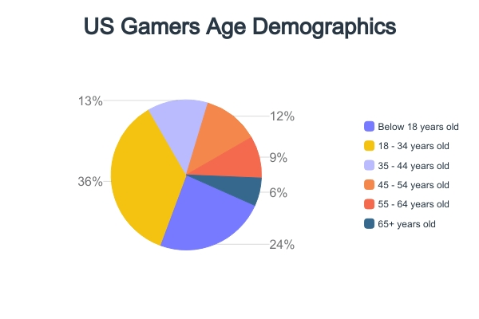
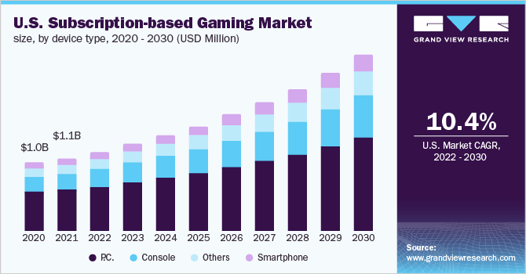
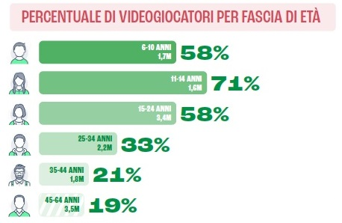
Why using videogames?
The players:
They are the main entertaining medium for children and adults.
Some numbers:
In 2022, Videogames market was worth about 347 billion US dollars,
expected to increase by 2030. The main players are
Sony, Microsoft and Nintendo.
Italian Players:
IMPROVING TRANSLITERACY SKILLS THROUGH SERIOUS GAMES, 29 GENNAIO 2024
IMPROVING TRANSLITERACY SKILLS THROUGH SERIOUS GAMES, 29 GENNAIO 2024

Slide 9
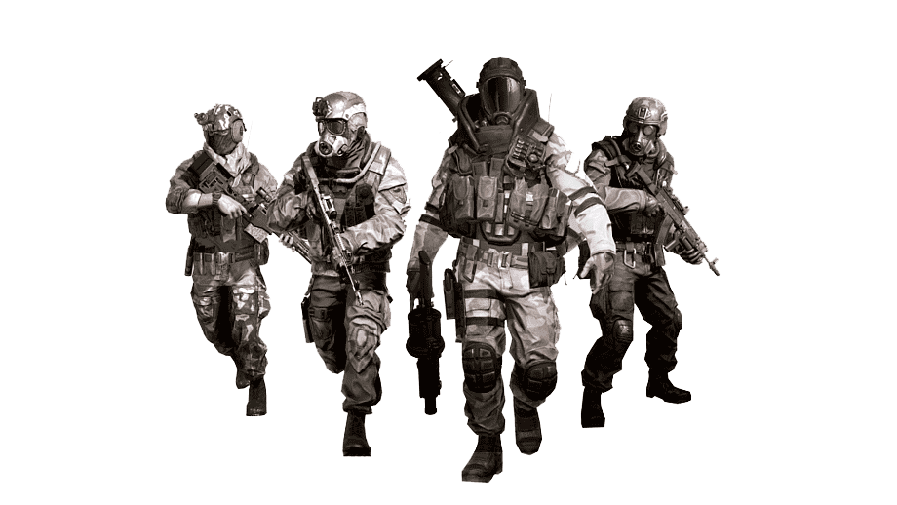
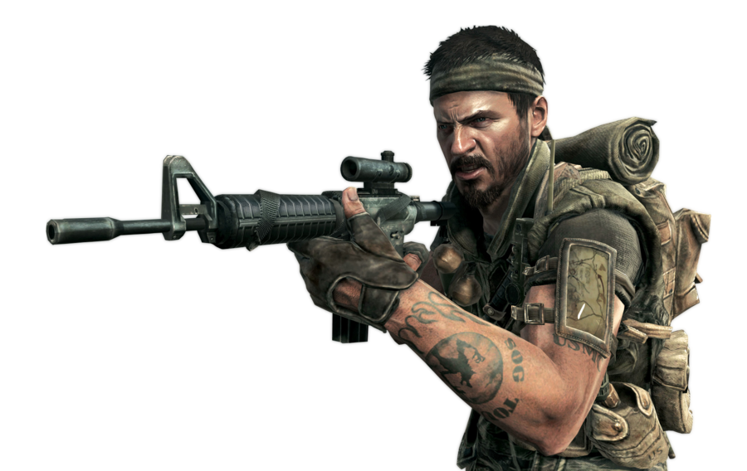
SOME EXAMPLE OF ENTERTAINING VIDEO GAMES TO TEACH SOFT SKILLS
Teamwork
Playing Call of Duty (and FPS in general) teaches Teamwork. Players have a specific role and they have to collaborate with other team members to win
Lrez, B.M. (2014)
Team building
Players have a specific role which lead to collaboration with other members to win and to reach objectives together and reach top rankings
Socialization
Players interact with other people and helps them socialize with other people. Often they play with friends leads to learning communication and social skills
IMPROVING TRANSLITERACY SKILLS THROUGH SERIOUS GAMES, 29 GENNAIO 2024

Slide 10
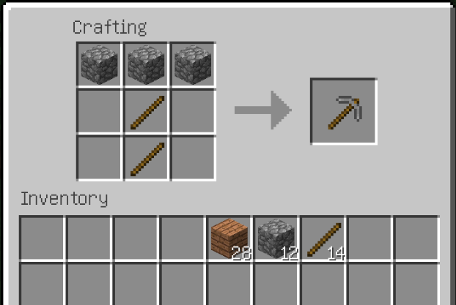
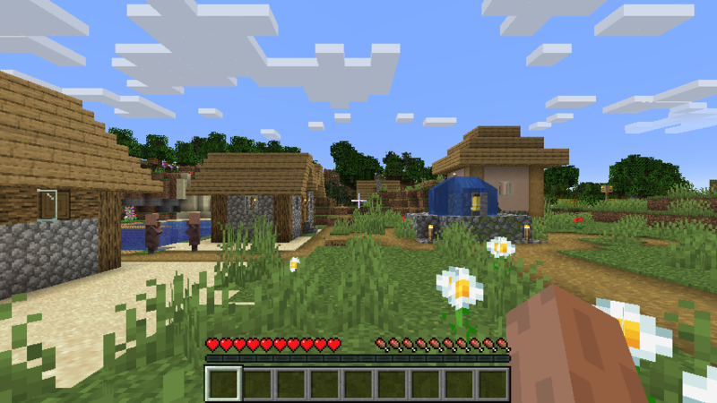
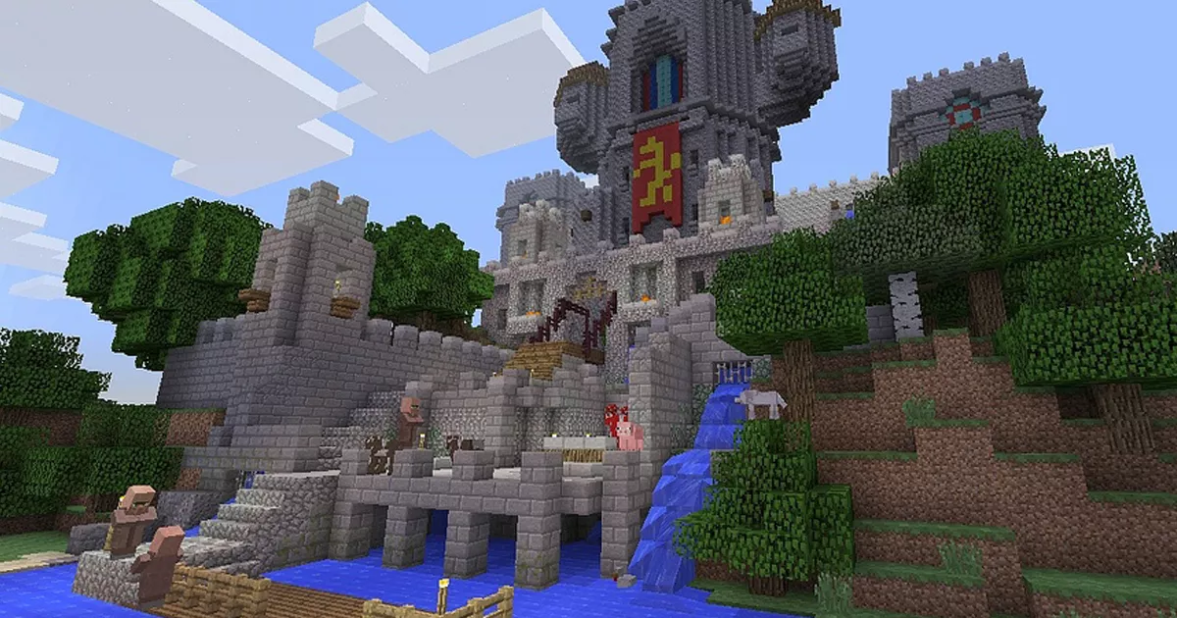
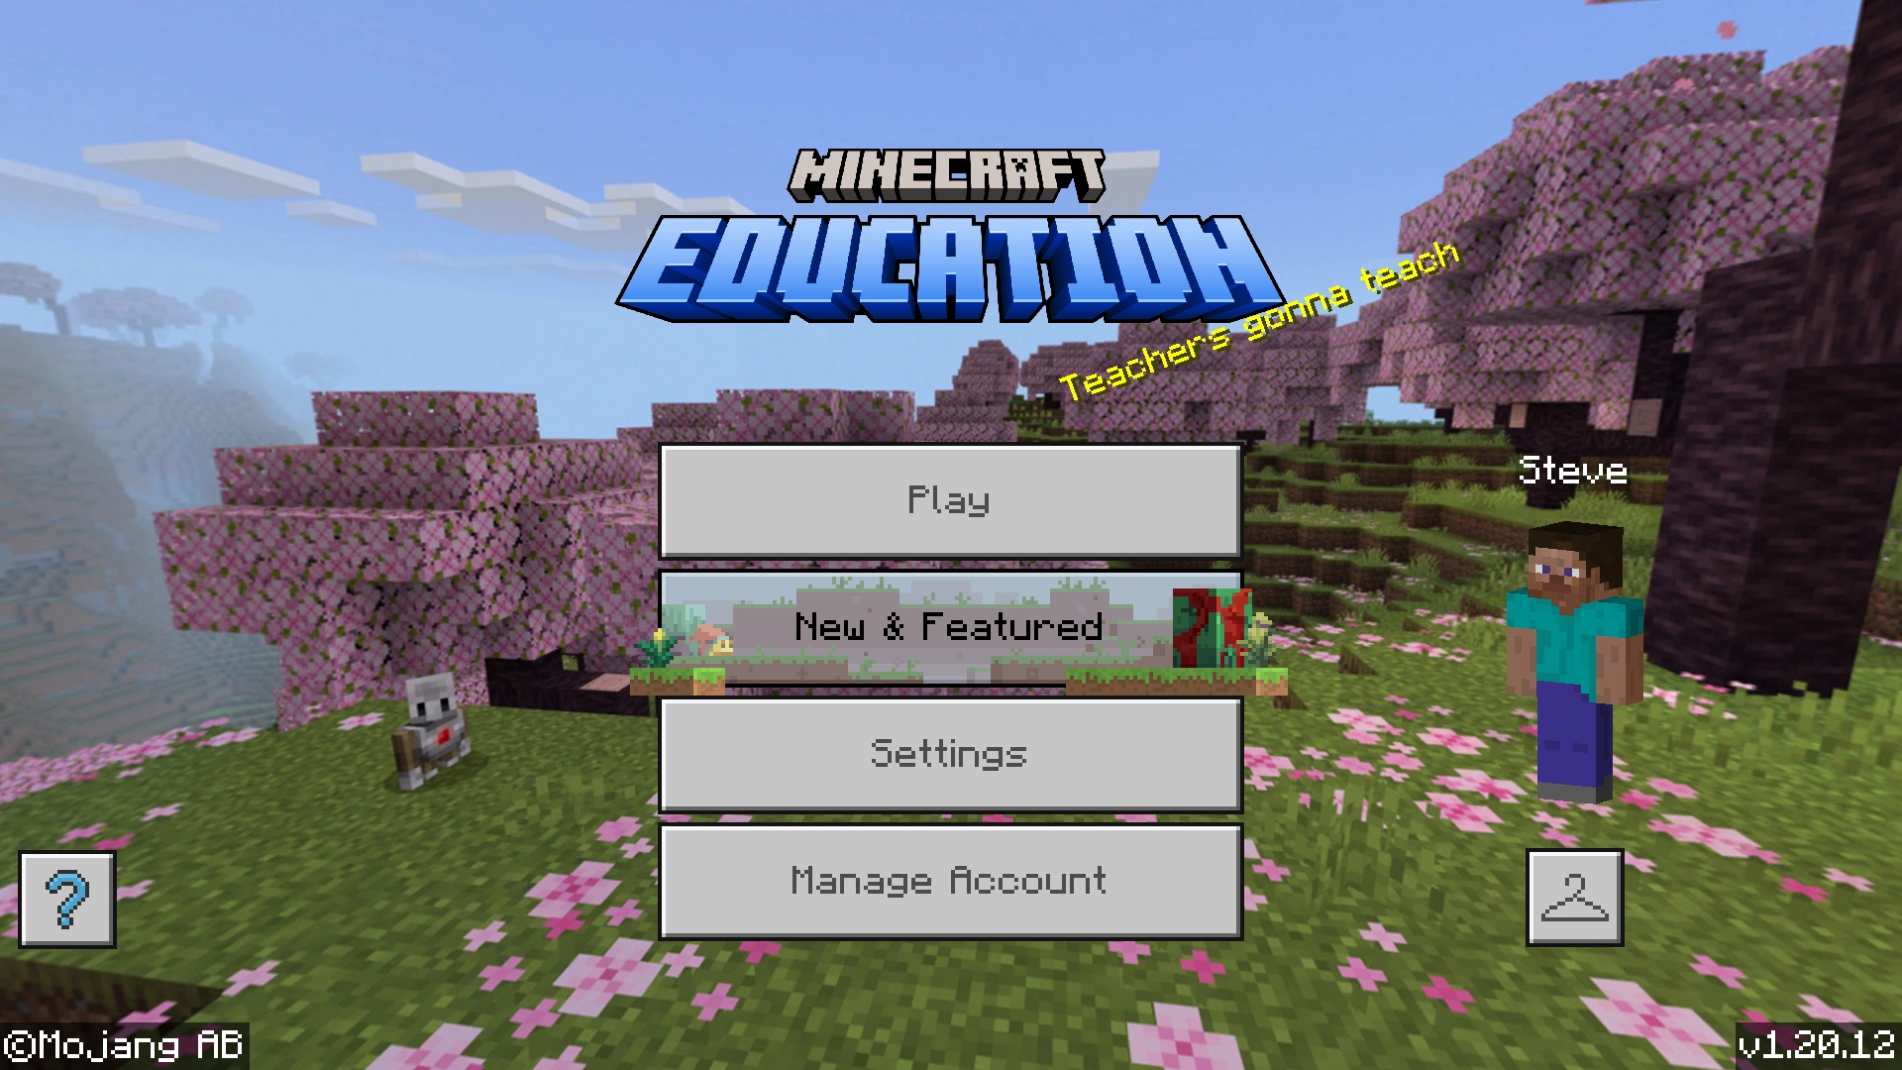
Exploration & Crafting:
By exploring in the game, players can learn mathematic and geometry skills.
By crafting they can learn methodical thinking and scientific notions
Crafting:
Creative Thinking:
Students learn to think creatively by constructing artistic and realistic structures alone and in group of other students.
(Nebel, Schneider, Rey, 2016; )
IMPROVING TRANSLITERACY SKILLS THROUGH SERIOUS GAMES, 29 GENNAIO 2024

Slide 11
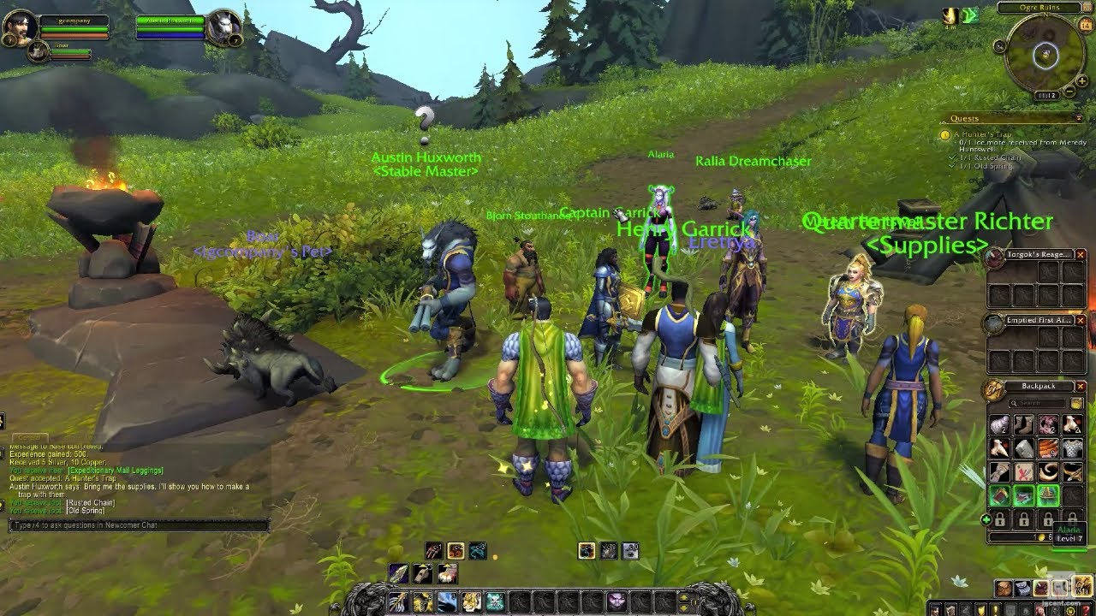
Two examples of videogames for L2 learning
#1: Andersen, 2019: The use of World of Warcraft for L2 learning with university students
Methods:
Objective:
- Pre-test (assessing)
- Middle test (valuating)
- Post-test (conclusion)
Duration: 3-4 months, with 3.5 hours per days in Spanish
Verify if the use of the MMORPG game Wold of Warcraft was useful to learn a L2. In this case, spanish
Results:
Partecipant:
Players showed a good increment of their Spanish level, in terms of words and vocaboulary.
Limitation: the level of Spanish was dependent to the in-game context
Two Norwegian secondary school students. Both gamers of WoW. Intermediate level of spanish

Slide 12
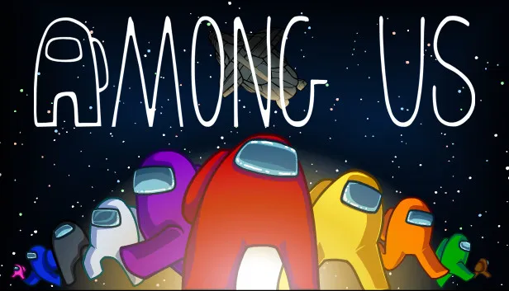
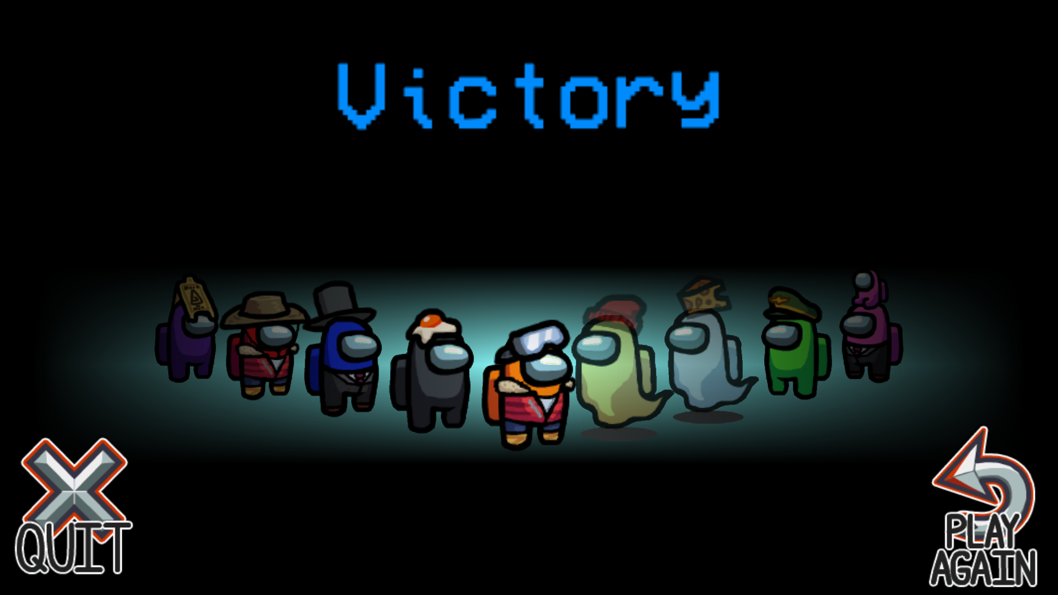
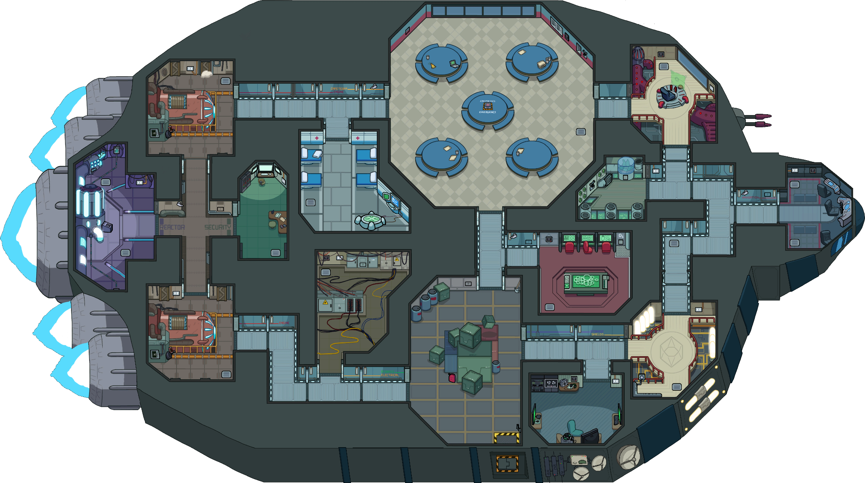
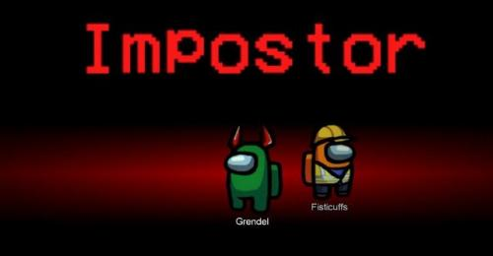
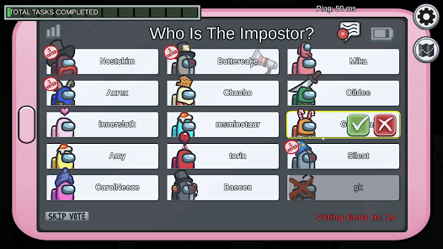
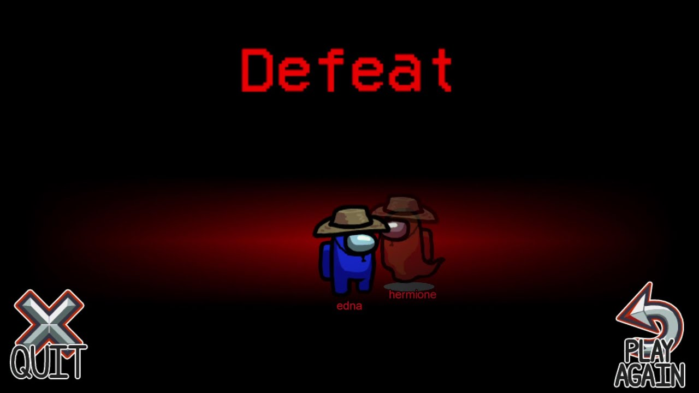
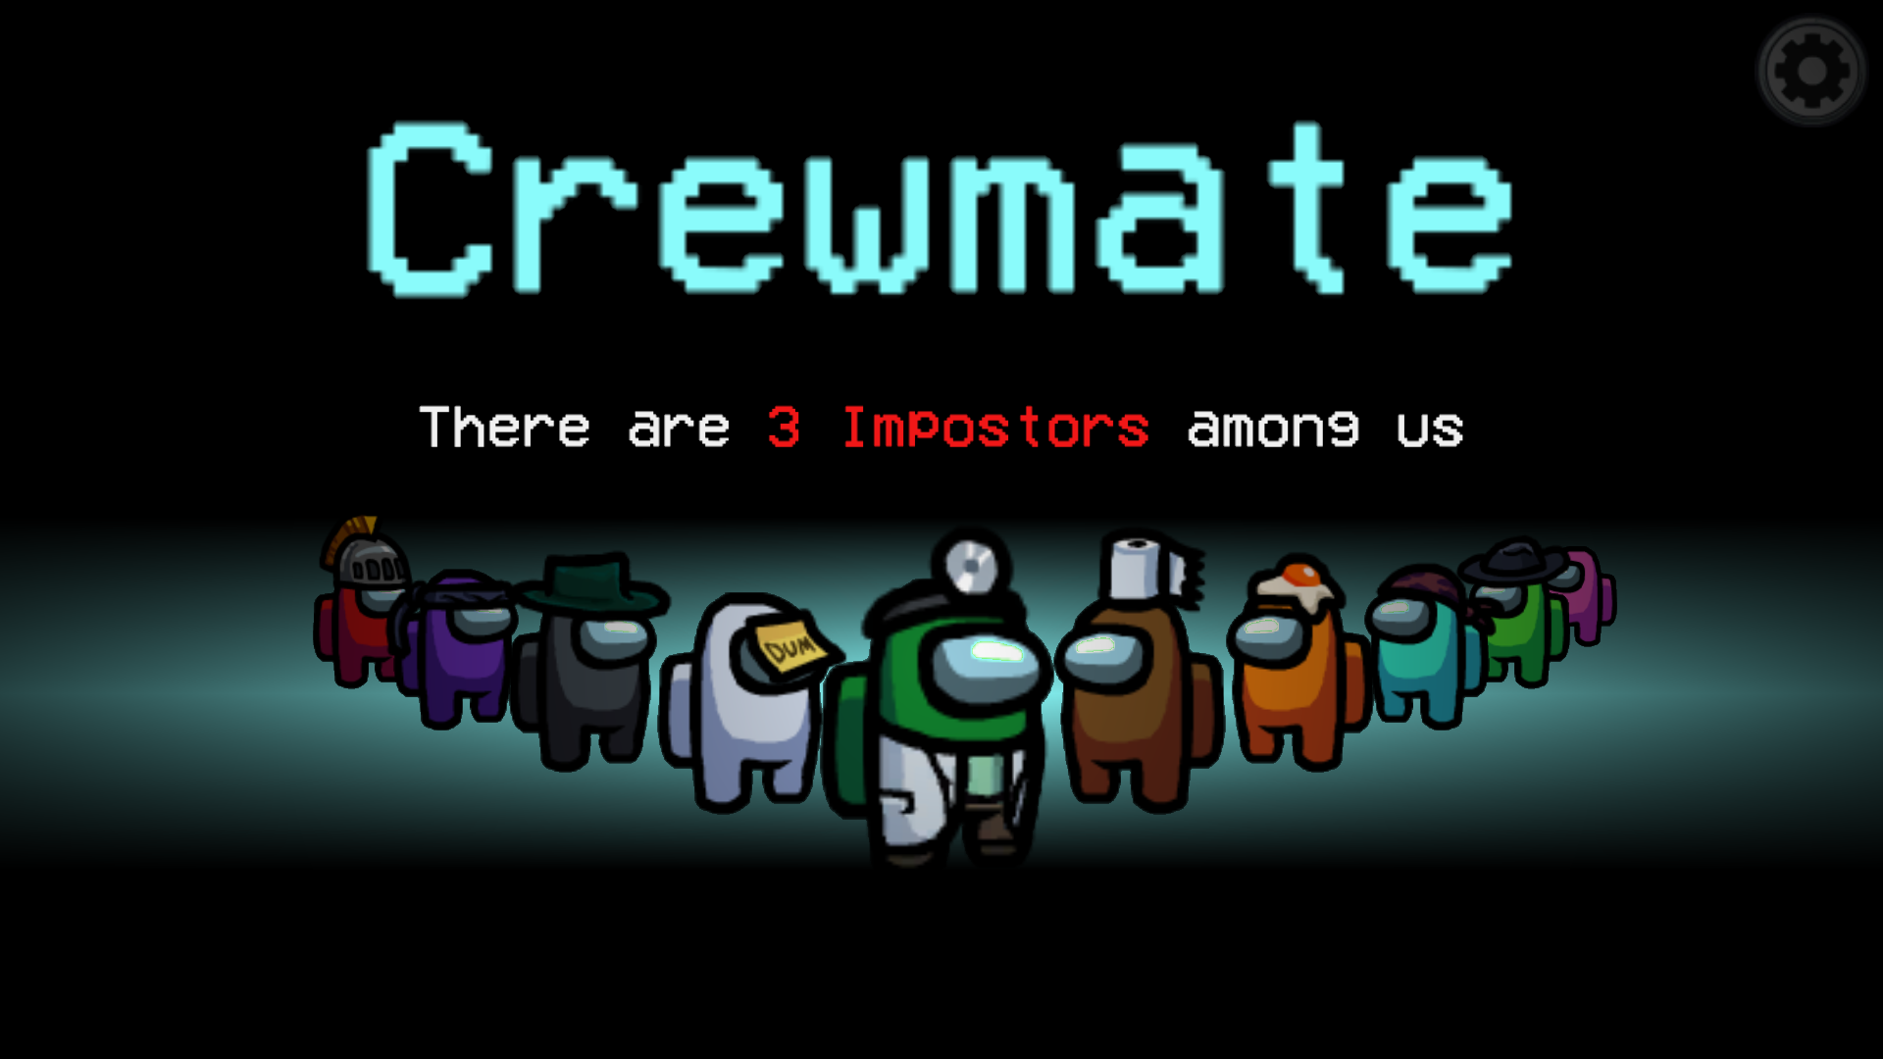
#2: José Ramón Calvo-Ferrer & Jose Belda-Medina (2021):
The case of Among Us
A survival deduction mobile game, came out in 2018.
It is playeble online. Every match is divided in 3 phases
Two endings:
Phase 3:
Player discussa about theyr suspects and vote to eliminate the impostor to eliminate him
Phase 1:
Players are divided in team.
Team Crewmate
Team Impostor
Victory: every impostor was found
Phase 2:
Player have to complete tasks in the spaceship, and try to findout the impostor, while this latter have to eliminate other players
Defeat: impostors killed everyone
IMPROVING TRANSLITERACY SKILLS THROUGH SERIOUS GAMES, 29 GENNAIO 2024

Slide 13
#2: José Ramón Calvo-Ferrer & Jose Belda-Medina (2021):
The case of Among Us
Objective: findout if playing Among Us in spanish was a good way to retain words and vocaboulary
Phase1: Pre- test, assessment and indetify 8 foreign words to appear in game
Phase2: Game session using these word with other players. One group used them intenitonally, other group just encount them
Phase3: Post-Test. players using new L2 words in the game Among Us would retain more vocabulary than players only encountering them
Results: Group of intentionally words players were more motivated to learn L2 and they retained more words and vocabulary while other group. The in-game learn was reflected also in a non-game context
IMPROVING TRANSLITERACY SKILLS THROUGH SERIOUS GAMES, 29 GENNAIO 2024

Slide 14
REFERENCES
Badatala, A., Leddo, J., Islam, A., Patel, K., & Surapaneni, P. (2016). The effects of playing cooperative and competitive video games on teamwork and team performance. International Journal of Humanities and Social Science Research, 2(12), 24-28.
Calvo-Ferrer J.R. & Belda-Medina J. (2021). The Effect of Multiplayer Video Games on Incidental and Intentional L2 Vocabulary Learning: The Case of Among Us. Multimodal Technologies and Interaction. 2021; 5(12):80.
Checa-Romero, M., & Pascual Gómez, I. (2018). Minecraft and machinima in action: Development of creativity in the classroom. Technology, Pedagogy and Education, 27(5), 625-637.
DeRosier, M. E., & Thomas, J. M. (2019). Hall of heroes: A digital game for social skills training with young adolescents. International Journal of Computer Games Technology, 2019.
Guerrero, Galvis and Héctor Alejandro. “Using Video Game-Based Instruction in an EFL Program: Understanding the Power of Video Games in Education.” Colombian Applied Linguistics Journal 13 (2011): 54-70.
Hitosugi, C. I., Schmidt, M., & Hayashi, K. (2014). Digital Game-based Learning (DGBL) in the L2 Classroom: The Impact of the UN’s Off-the-Shelf Videogame, Food Force, on Learner Affect and Vocabulary Retention. CALICO Journal, 31(1), 19–39.
Li, J. (2020). A Systematic Review of Video Games for Second Language Acquisition. Handbook of Research on Integrating Digital Technology With Literacy Pedagogies.
Lrez, B. M. (2014). Graphics, playability and social interaction, the greatest motivations for playing Call of Duty. Educational reflections. Journal of New Approaches in Educational Research (NAER Journal), 3(1), 34-41.
Nebel, S., Schneider, S., & Rey, G. D. (2016). Mining learning and crafting scientific experiments: a literature review on the use of minecraft in education and research. Journal of Educational Technology & Society, 19(2), 355-366.
Shin, E. & Kim, J. (2022). The Metaverse and Video Games: Merging Media to Improve Soft Skills Training. Journal of Internet Computing and Services, 23(1), 69-76.
Sutil-Martín, D.L.; Otamendi, F.J. (2021). Soft Skills Training Program Based on Serious Games. Sustainability, 13(15), 8582.
IMPROVING TRANSLITERACY SKILLS THROUGH SERIOUS GAMES, 29 GENNAIO 2024

Slide 15
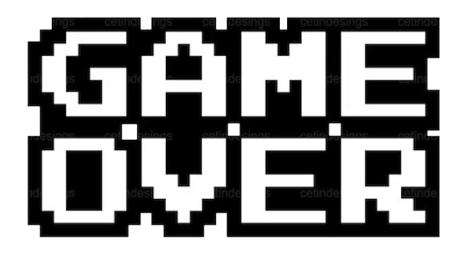
Thank you for your attention!
Angelo Mirra (a.mirra@lumsastud.it)
Silvia Dini (silvia.dini@unipr.it)
IMPROVING TRANSLITERACY SKILLS THROUGH SERIOUS GAMES, 29 GENNAIO 2024

