Slide 1
Immersive Learning in the Time of AI: The Information Specialist’s Perspective
https://bit.ly/TLIT4Uparma
Plamen Miltenoff, PhD, MLIS
Parma, January 29, 2024
https://www.linkedin.com/in/miltenoff/

Slide 2
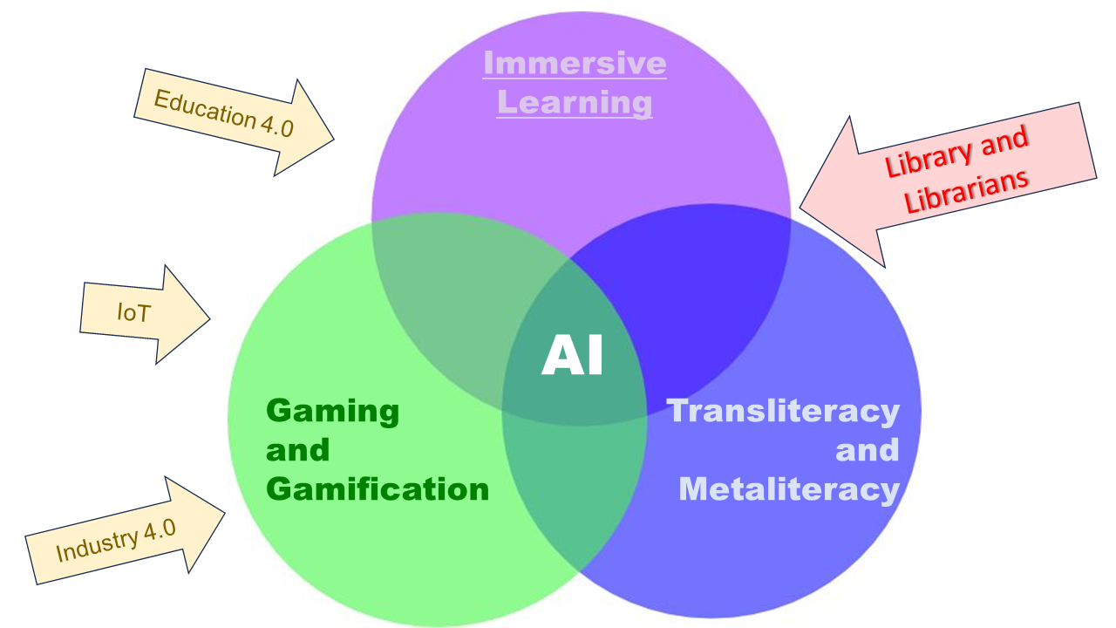
Plan
Gaming and gamification
Transliteracy and metaliteracy
Immersive learning
AI
The role of librarians and info specialists
The big picture
Notes:
OUTLINE the role of the academic library in connecting artificial intelligence, immersive learning, transliteracy and gaming and gamification

Slide 3
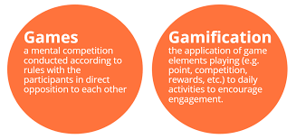

Slide 4
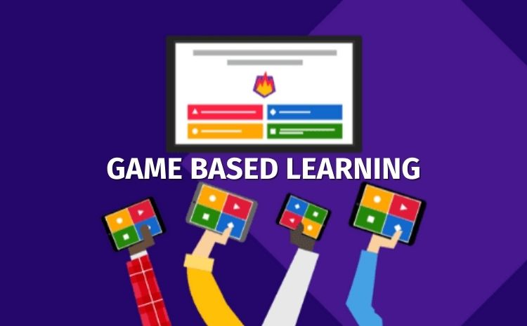
About the naming ….
Games in Education: Play >>> Games >>> Serious Games >>> >>> Game-Based Learning >>> >>> Digital Game-Based Learning
Gamification in Education Gamification refers to an educational approach that allows students to see their learning as a playful process and experience.
GBL, Game Based Learning: Game-based learning is an instructional method that allows students to experience, understand, and solve problems in the world of a particular subject, or system, from the inside.
Notes:
The :Naming”: play, games, serious games, GBL, DGBL, etc
https://blog.stcloudstate.edu/ims/2015/05/31/dgbl-and-digital-literacies/

Slide 5
Games in Education
Gaming in education is recognized with the potential to promote student motivation and problem-solving skills. (Miltenoff, 2016, p. 5)
Gaming as a teaching tool
Are Games Effective Learning Tools?
Notes:
Miltenoff, Plamen, "Gaming, Gamification and BYOD in academic and library settings: bibliographic overview" (2015). Library Faculty Publications. 46. https://repository.stcloudstate.edu/lrs_facpubs/46
de Freitas, S. (2018). Are Games Effective Learning Tools? A Review of Educational Games. Journal of Educational Technology & Society, 21(2), 74–84. https://www.jstor.org/stable/26388380

Slide 6
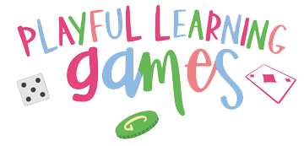
Games at libraries
Why games in the libraries
Gamification for Learning: Utilize gamification and game-based learning to support next-generation job skills and information literacy.
Engagement and Promotion: Leverage games to engage the community and promote the library.
Playful Learning: Embrace playful learning in the library by using games as a tool for learning and promoting the library to the community.
Recommendations for promoting games at a Library

Slide 7
Gaming, gamification and digital literacies
Digital Literacies , (Digital Fluency) The ability to use information and communication technologies to find, evaluate, create, and communicate information, requiring both cognitive and technical skills (ALA’s Digital Literacy Task Force).
Gamification and gaming are increasingly recognized as valuable tools for promoting digital literacies by making learning more engaging, motivating, and effective. By incorporating game elements into educational contexts, educators can enhance the development of essential digital competencies in students, ultimately preparing them for success in the 21st century (Schrum and Sumerfield, 2018)
Notes:
Digital Literacy – Welcome to ALA’s Literacy Clearinghouse. (n.d.). Retrieved January 18, 2024, from https://literacy.ala.org/digital-literacy/
Schrum, L., & Sumerfield, S. (2018). Learning Supercharged: Digital Age Strategies and Insights from the EdTech Frontier. International Society for Technology in Education.
How can you use gamification to teach digital literacy skills in higher education? (n.d.). Retrieved January 18, 2024, from https://www.linkedin.com/advice/3/how-can-you-use-gamification-teach-digital-literacy

Slide 8
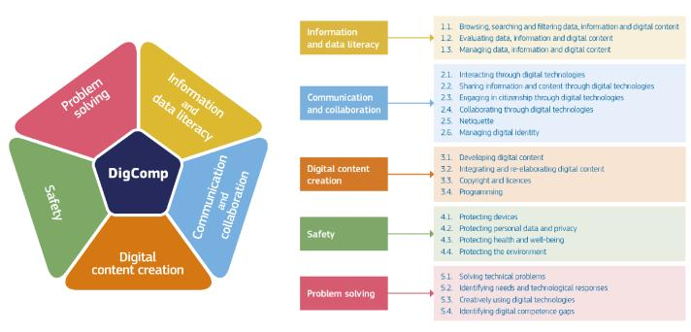
Digital Competency Frame (DigComp) (EU)
Notes:
https://joint-research-centre.ec.europa.eu/digcomp_en
DigComp 2.2 (March, 2022) is the fourth iteration of the framework.

Slide 9
US Digital Literacy Accelerator
The Office of Educational Technology (OET) at the U.S. Department of Education is actively looking for ways to promote digital literacy.
Notes:
https://tech.ed.gov/launching-a-digital-literacy-accelerator/

Slide 10
Academic libraries leverage games to support education
Enhancing Information Literacy: Games are used to teach information literacy concepts, engaging students in a more interactive and enjoyable learning experience.
Fostering Community and Engagement: Games help in building a sense of community among students and drawing them into the library. This is particularly beneficial for urban academic libraries.
Supporting New Degree Programs: Academic libraries are building collections of video games to support newly created degree programs, demonstrating the role of games in aligning with and supporting the curriculum of the institution

Slide 11
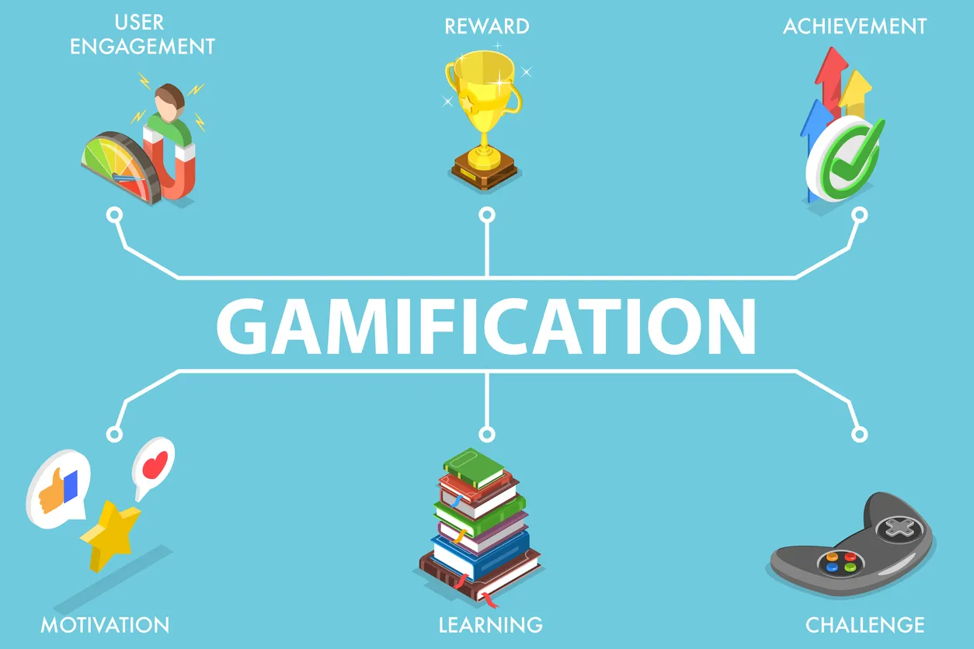
Gamification - definition
Gamification and GBL need to be distinguished.
Gamification is the use of game mechanics in a non-game environment.
Gamification integrates game elements:
point systems,
leaderboards,
badges,
or other elements
related to games into learning activities in order to increase engagement and motivation (Kim et al, 2018).
Notes:
Kim, S., Song, K., Lockee, B., and Burton, J. (2018). Gamification in Learning and Education. Springer.

Slide 12
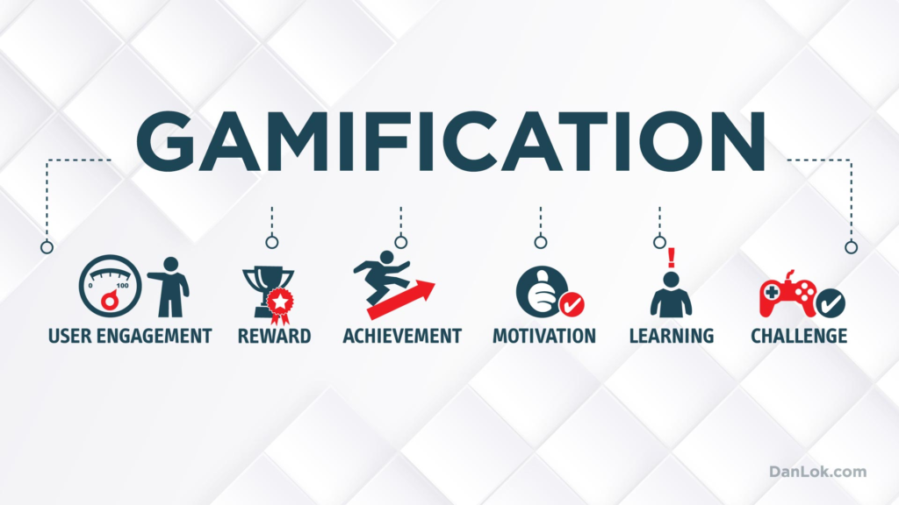
Gamification in Education: Pros and Cons
Pros:
Enhance learner engagement
Provide valuable feedback
Promotes Desired Behaviors
Develops Problem-Solving Skills
Fosters Collaboration
Cons
Cost of Development
Requires Access to Technology
Diminished Value Over Time
Possible Overstimulation or Addiction
Distraction from Learning Objectives
Notes:
Park, S. H. (Sunny). (2022). Gamification and Game Based Learning in Online Education. https://pressbooks.pub/techcurr20221/chapter/gamification-and-gbl-in-online-education/
“Having gamification in between modules not only motivates students but gives a nice break for students to review what they have learned and even promotes competitiveness and interest among students. Some of the negative effects of gamification is playing games that don’t offer in-depth content related to the learning theme.”

Slide 13
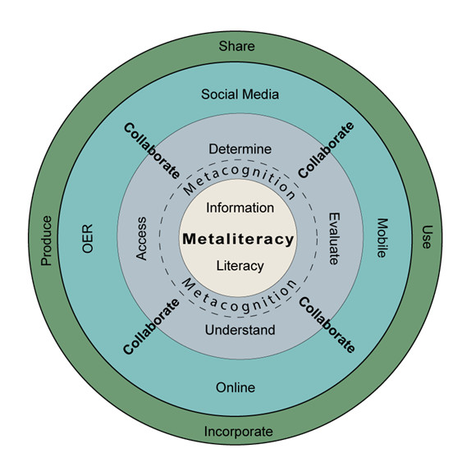
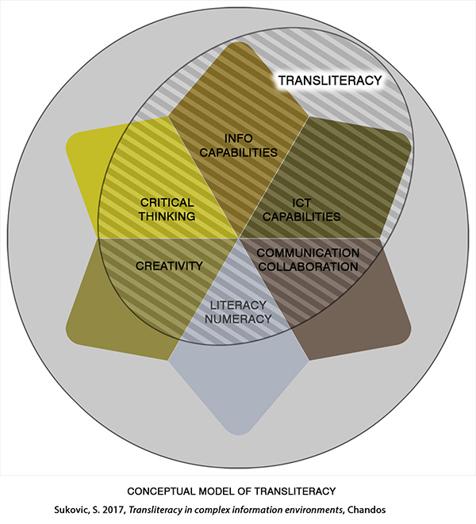
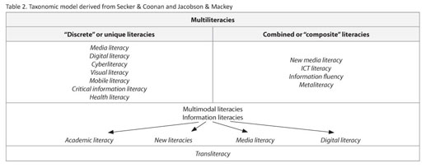
Transliteracy
Notes:
Miguel-&Aacute, & Marzal, N. (2020). A taxonomic proposal for multiliteracies and their competences. El Profesional de La Informacion, 29(4), NA-NA.

Slide 14
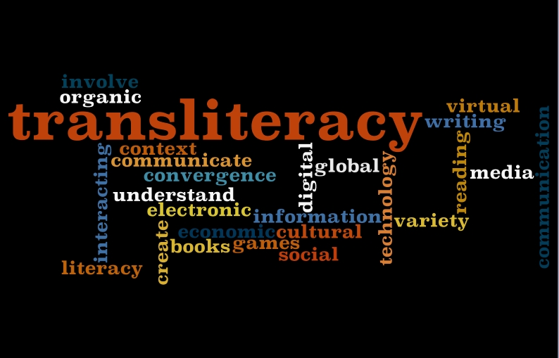
Transliteracy Definition
Transliteracy is a concept
that has gained attention in the library world, encompassing the ability to
read, write, and interact
across various platforms, tools, and media.

Slide 15
Transliteracy and the libraries
“...transliteracy is concerned with what it means to be literate in the 21st century.
It analyzes the relationship between people and technology, most specifically social networking, but is fluid enough to not be tied to any particular technology.
It focuses more on the social uses of technology, whatever that technology may be.
This terminology is new and the study of transliteracy is in the early stages, so this definition is likely to evolve.” (Ipri, 2010)
Notes:
Ipri, T. (2010). Introducing transliteracy: What does it mean to academic libraries? | Ipri | College & Research Libraries News. https://doi.org/10.5860/crln.71.10.8455

Slide 16
Transliteracy, Multiliteracy, and the Libraries
Should information literacy be multiliteracy? Transliteracy?
Transliteracy is an emerging concept that challenges the current structures of information literacy and scholarly communication programs alike.
This is a key area where scholarly communication and information literacy intersect
Notes:
Intersections of Scholarly Communication and Information Literacy: Creating Strategic Collaborations for a Changing Academic Environment. (2013). https://acrl.libguides.com/intersections/roadshow/intersections

Slide 17
Transliteracy, Multiliteracy, and the Libraries
The essential idea here is that transliteracy is concerned with mapping meaning across different media and
not with developing particular literacies about various media.
It is not about learning text literacy and visual literacy and digital literacy in isolation from one another but about the interaction among all these literacies.
Notes:
Intersections of Scholarly Communication and Information Literacy: Creating Strategic Collaborations for a Changing Academic Environment. (2013). https://acrl.libguides.com/intersections/roadshow/intersections

Slide 18
Transliteracies, Metaliteracies, Digital Humanities
Digital humanities often encompass both metaliteracy and transliteracy, as they involve the use of digital tools and platforms to engage with and create meaning from various sources of information and communication (Cobourn et al, 2022).
Notes:
Cobourn, A. B., Brown, J. C., Warga, E., & Louis, L. (2022). Toward Metaliteracy and Transliteracy in the History Classroom: A Case Study Among Underserved Students. The American Archivist, 85(2), 587–608. https://doi.org/10.17723/2327-9702-85.2.587

Slide 19
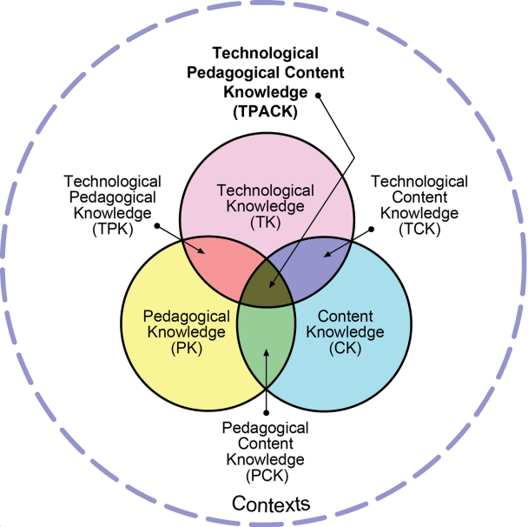
The TPACK Framework and Transliteracy
The Technological Pedagogical Content Knowledge (TPACK) framework emphasizes the integration of technology with pedagogy and content knowledge.
By incorporating a model of pedagogy like TPACK, educators can develop a deeper understanding of transliteracy skills and concepts.
Both concepts highlight the need for educators to be proficient in using technology to support diverse literacy practices and learning needs.

Slide 20
Transliteracy and the libraries
5th European Conference on Information Literacy (ECIL2017), https://ecil2017.ilconf.org/
Topics of the Conference include
literacy, visual literacy, health literacy, multi literacy, civic literacy, transliteracy, metaliteracy, e-literacy, digital literacy, computer literacy, scientific literacy, Information literacy and related concepts (transversal competencies, media literacy, data literacy
Notes:
https://news.adobe.com/news/news-details/2024/Media-Alert-Adobe-Premiere-Pro-Innovations-Make-Audio-Editing-Faster-Easier-and-More-Intuitive/default.aspx?utm_source=www.therundown.ai&utm_medium=newsletter&utm_campaign=a-new-era-of-mobile-ai-is-here

Slide 21
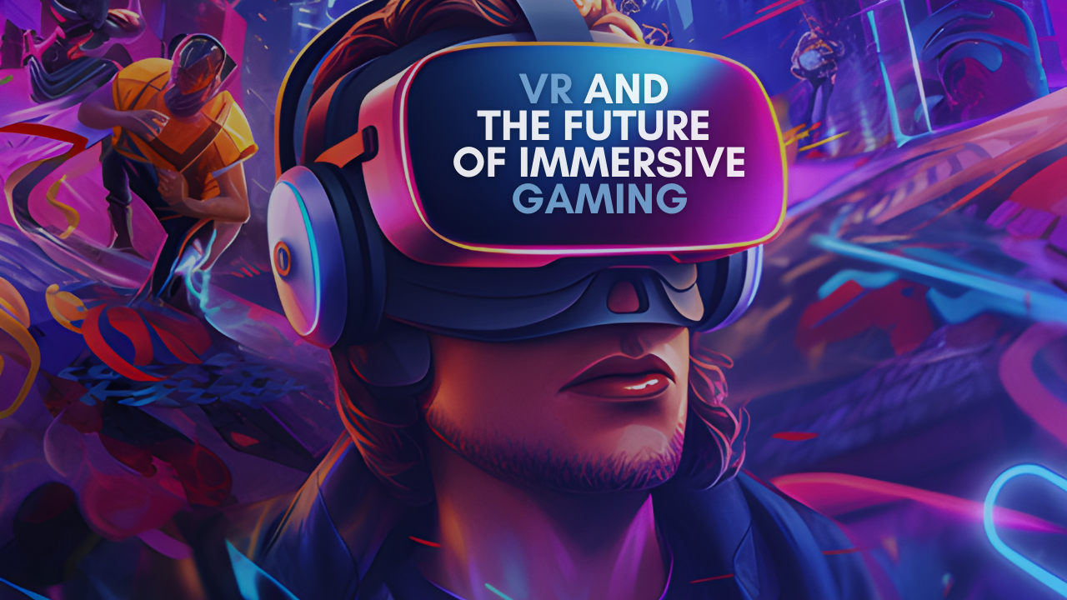
Immersive Learning
Notes:
immersive

Slide 22
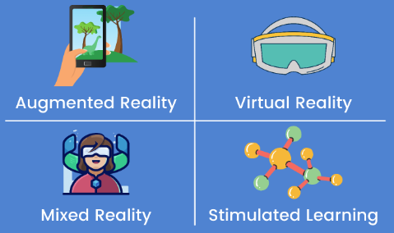
Immersive Learning
Immersive learning is a learning method with students being immersed into a virtual dialogue, the feeling of presence is used as an evidence of getting immersed.
The motivations of using virtual reality (VR) for teaching contain: learning efficiency, time problems, physical inaccessibility, limits due to a dangerous situation and ethical problems (Wikipedia).

Slide 23
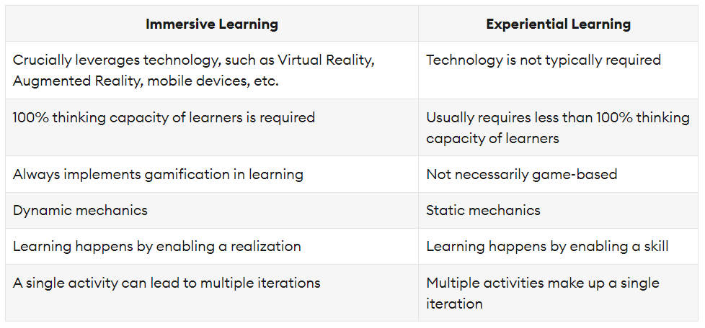
Immersive Learning
Notes:
https://elearningindustry.com/everything-need-know-about-immersive-learning

Slide 24
Immersive (XR) technologies
Virtual Reality (VR) This technology makes use of digital simulations to recreate real-world scenarios. By wearing a headset, the user becomes immersed in the virtual world and can travel to the most physically inaccessible places.
Augmented Reality (AR) Enhancing your real-world view, Augmented Reality is a technology that augments real environments into a digital interface. AR adds digital elements to reality to enhance it.
Mixed reality (MR) A combination of Augmented Reality and Virtual Reality, MR or mixed reality is a technology that makes virtual interactions look more realistic. MR lets digital and physical objects co-exist and interact in real-time.
Notes:
https://elearningindustry.com/everything-need-know-about-immersive-learning
Immersive in Education

Slide 25
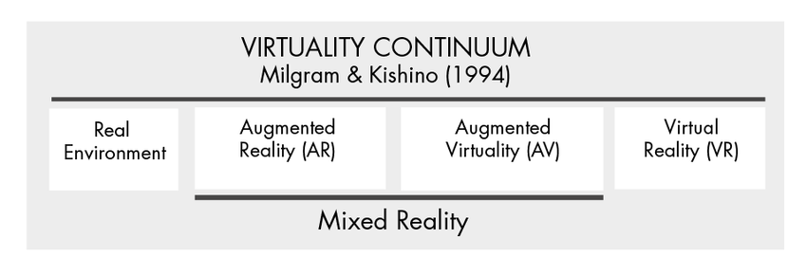
Immersive Technologies Definitions
Rauschnabel, P. A., Felix, R., Hinsch, C., Shahab, H., & Alt, F. (2022). What is XR? Towards a Framework for Augmented and Virtual Reality. Computers in Human Behavior, 133, 107289. https://doi.org/10.1016/j.chb.2022.107289
Abeywardena, I. S. (2023). OXREF: Open XR for Education Framework. The International Review of Research in Open and Distributed Learning, 24(3), 185–206. https://doi.org/10.19173/irrodl.v24i3.7109

Slide 26
Immersive Learning and Transliteracy
Immersive learning and transliteracy intersect in various ways, including the use of:
multiliteracies,
technology-based language,
disciplinary transliteracy,
simultaneous and reciprocal transliteracy practices,
social transliteracy,
transliteracy through research,
and the intersection with scholarly communication and information literacy.
Notes:
Cooper, R. S., Danielle. (2019, March 14). Guest Post - Pictures Worth a Thousand Words? On Visualizations of Scholarly Workflow. The Scholarly Kitchen. https://scholarlykitchen.sspnet.org/2019/03/14/guest-post-pictures-worth-a-thousand-words-on-visualizations-of-scholarly-workflow/

Slide 27
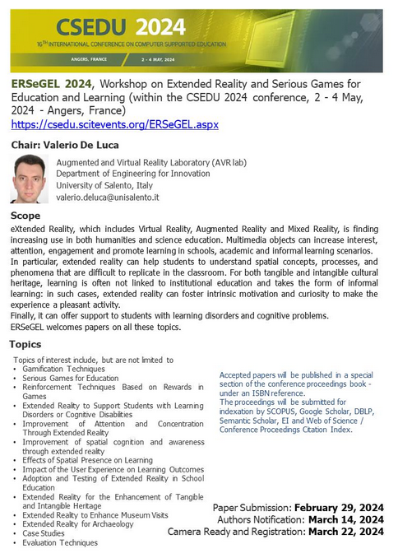
Immersive and Serious Games
https://csedu.scitevents.org/ERSeGEL.aspx
Workshop on Extended Reality and Serious Games for Education and Learning - ERSeGEL 2024
2 - 4 May, 2024 - Angers, France
Paper Submission: February 29, 2024
Authors Notification: March 14, 2024
Camera Ready and Registration: March 22, 2024

Slide 28
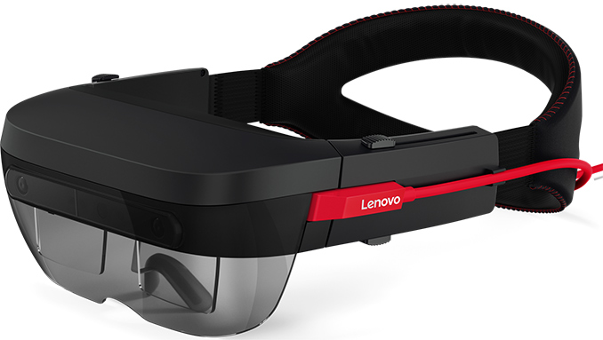
EngageVR and Lenovo
Engage is an enterprise education focused platform, creating content using unique tools for their own use cases (Middlemiss, 2024)
Virtual worlds (EngageVR) + hardware (Lenovo) = Simplifying XR
Notes:
Middlemiss, M. (2024, January 17). The Dawn of GenAI-driven Realities: ENGAGE XR and Lenovo Redefine Interactive Learning. XR Today. https://www.xrtoday.com/mixed-reality/the-dawn-of-genai-driven-realities-engage-xr-and-lenovo-redefine-interactive-learning/

Slide 29
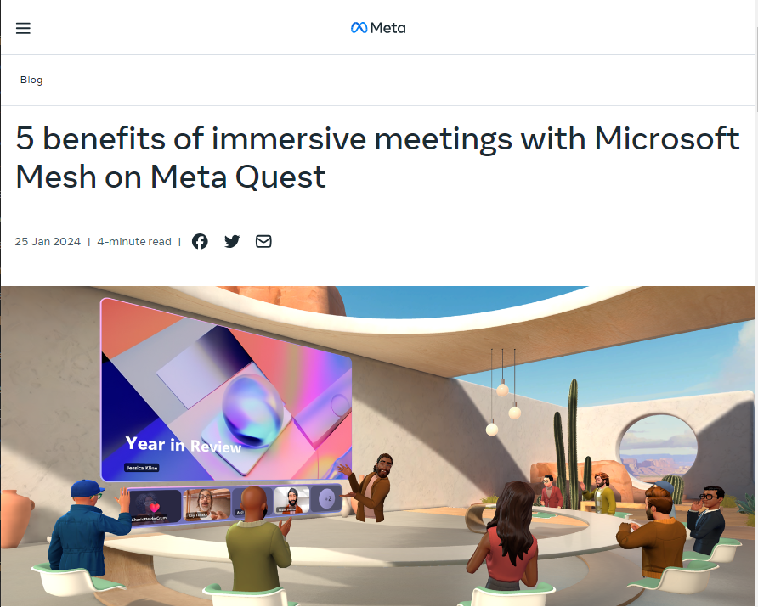
Microsoft Mesh and Meta Quest
Microsoft Mesh now available on Meta Quest
Notes:
Work, M. for. (2024, January 25). Transforming workplace collaboration with Microsoft Mesh and Meta Quest | Meta for Work. Meta Workportfolio Blog. https://forwork.meta.com/gb/blog/microsoft-mesh-meta-quest-immersive-meetings/

Slide 30
AI metaverse for personalized learning
AI metaverse education is a form of online education that uses AI to create, deliver, and assess learning experiences in the metaverse.
The metaverse is a term that refers to a shared, persistent, and interactive virtual world that can be accessed by multiple users through various devices.
AI metaverse education can leverage the features of the metaverse, such as 3D graphics, spatial audio, avatars, and social interactions, to create immersive and engaging learning scenarios that can be tailored to the needs and preferences of each learner.
Notes:
Hirsch-Pasek, K., Zosh, J., Shwe Hadani, H., Michnick Golinkoff, R., Clark, K., Donohue, C., & Wartell, E. (2022, February 12). A whole new world: Education meets the metaverse. Brookings. https://www.brookings.edu/articles/a-whole-new-world-education-meets-the-metaverse/
LinkedIn Community. (n.d.). How can AI metaverse education support personalized and adaptive learning pathways for learners? Metaverse. Retrieved January 25, 2024, from https://www.linkedin.com/advice/0/how-can-ai-metaverse-education-support-personalized-adaptive

Slide 31
The convergence between Immersive (XR) and AI
An example for the convergence of AI and XR:
MedivisAR, an FDA-cleared, AI-powered, AR platform for surgeries.
View video: https://twitter.com/MGalvosas/status/1748700907049746794
Notes:
Reiners, D., Davahli, M. R., Karwowski, W., & Cruz-Neira, C. (2021). The Combination of Artificial Intelligence and Extended Reality: A Systematic Review. Frontiers in Virtual Reality, 2. https://www.frontiersin.org/articles/10.3389/frvir.2021.721933

Slide 32
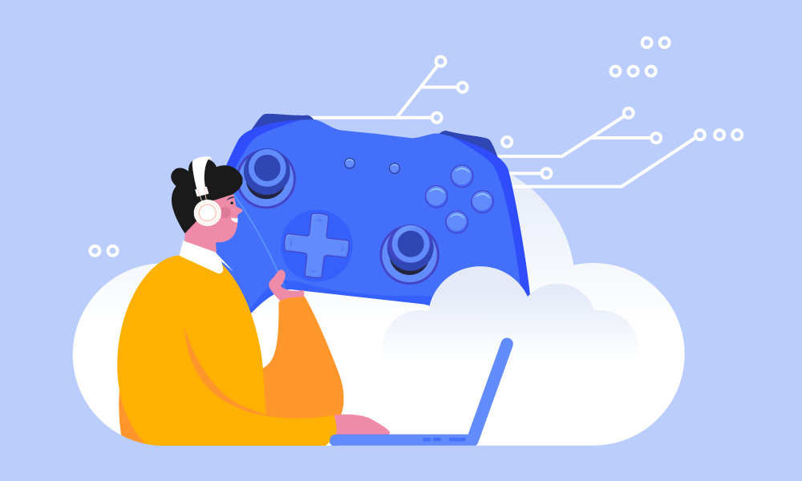
AI

Slide 33
The intersection of AI and the rest
The potential of
AI and immersive technologies using
gaming and gamification and transliteracy
to transform education
by personalizing learning experiences,
making learning more accessible, and
enhancing student engagement and motivation (Martin, 2023)
Notes:
Martin, E. (2023, October 6). The Future Of eLearning: How AR, VR, And AI Are Changing The Game. eLearning Industry. https://elearningindustry.com/future-of-elearning-how-ar-vr-and-ai-are-changing-the-game

Slide 34
Game-based Learning with AI and Immersive Technologies
AI is revolutionizing the gaming industry, creating immersive and realistic experiences (NexGen Solutions Group, 2023).
Game-Based Learning (GBL) with immersive technologies is effectively used for teaching and learning various subjects such as mathematics, foreign languages, and physics (Dyulicheva et al, 2021).
AI is being leveraged to design games that take into account individual preferences and provide customized, adaptive learning paths, making education a fun endeavor.
Notes:
NexGenAI Solutions Group. (2023, July 14). Unlocking Immersive Gaming: How AI is Revolutionizing the Virtual Realm with Realistic Experiences | LinkedIn. https://www.linkedin.com/pulse/unlocking-immersive-gaming-how-ai-revolutionizing/
Dyulicheva, Y. Y., & Glazieva, A. O. (2021). Game based learning with artificial intelligence and immersive technologies: An overview. https://ceur-ws.org/Vol-3077/paper05.pdf

Slide 35
Adaptive Gaming Learning Environments
AI is used to adapt content on the fly based on users' performance and feedback in immersive learning experiences.
Educators and instructional designers must balance the benefits of technology with the essence of education.
The potential is to develop immersive learning that not only informs but is also inclusive, engaging and tailored to individual learners (Digital Learning Institute, 2023).
Notes:
Digital Learning Institute. (2023, December 5). Diving Deeper into Digital: How AI is Elevating Immersive Learning Experiences. Digital Learning Institute. https://www.digitallearninginstitute.com/blog/how-ai-is-elevating-immersive-learning-experiences

Slide 36
Notes:
https://www.projectlambo.io/

Slide 37
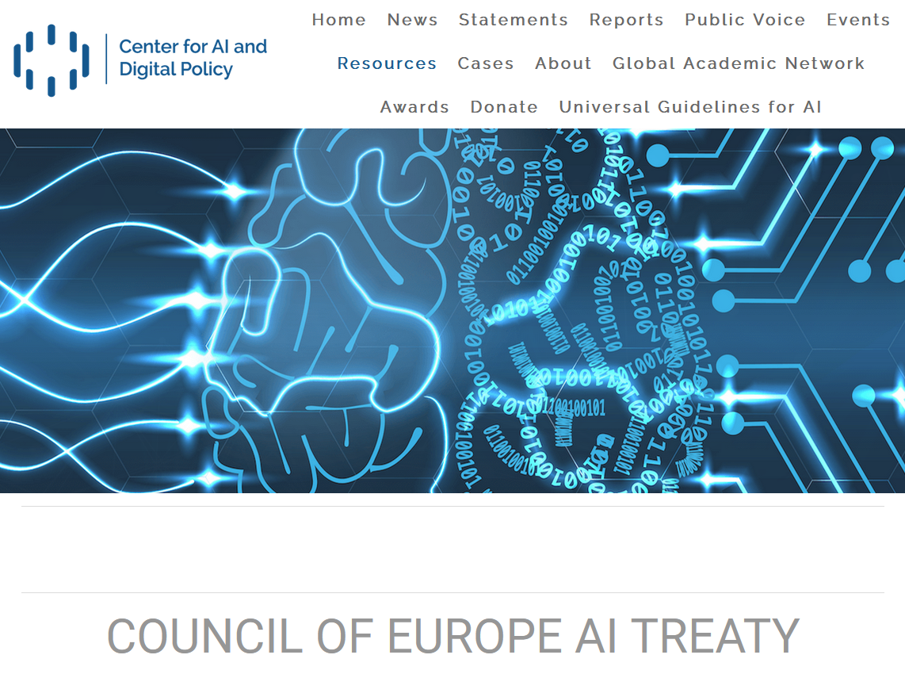
Notes:
https://www.caidp.org/resources/coe-ai-treaty/

Slide 38
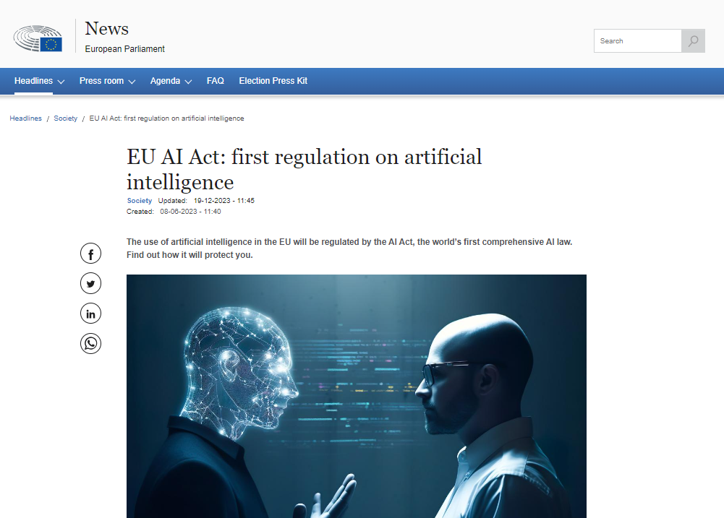
Notes:
https://www.europarl.europa.eu/news/en/headlines/society/20230601STO93804/eu-ai-act-first-regulation-on-artificial-intelligence

Slide 39
AI Literacy (#ailiteracy)
an AI literacy session for first-year students in an academic library
Understanding AI Basics:
Explain what artificial intelligence (AI) is and how it is used in various applications, such as social media, online recommendations, and virtual assistants (e.g. watch this video)
Ethical and Responsible AI Use:
Emphasize the importance of ethical and responsible AI use, including the potential biases in AI systems and the consequences of AI bias (video)
Practical Applications and Impact:
Explore AI integration into daily life, its benefits, and its potential impact on various industries and professions.

Slide 40
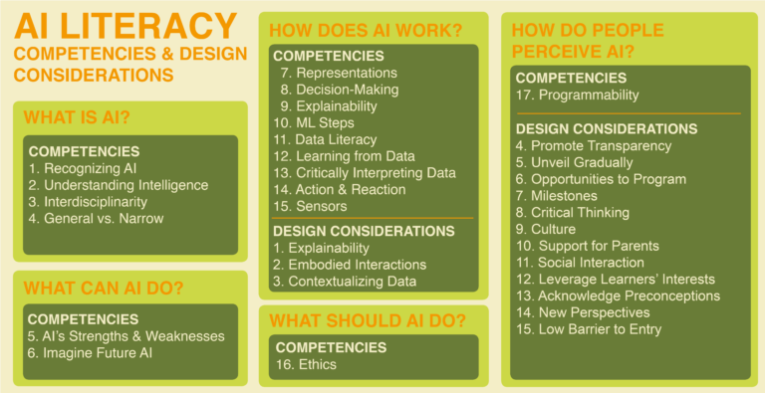
Notes:
https://aiunplugged.lmc.gatech.edu/ai-literacy/

Slide 41
The role of librarians and info specialists

Slide 42
The role of librarians and info specialists
The library serves as a hub in connecting artificial intelligence (AI), immersive learning, transliteracy, and gaming and gamification.
The library facilitates the adoption of emerging technologies, such as AI and gamification, by conducting long-term research and providing training for staff and faculty (Miltenoff et al, 2015).
The academic library acts as a leader in promoting innovative and interactive learning approaches by integrating AI, immersive learning, transliteracy, and gaming and gamification into its services and resources.
Notes:
Miltenoff, P., Martinova, G., & Todorova, R. (2015, July 8). GAMING AND GAMIFICATION IN ACADEMIC AND LIBRARY SETTINGS: BIBLIOGRAPHIC OVERVIEW. Sociopoint 2 Nd INTERNATIONAL CONFERENCE ON EDUCATION, SOCIAL SCIENCES AND HUMANITIES. Proceedings of SOCIOINT15- 2 nd International Conference on Education, Social Sciences and Humanities, Instanbul, Turkey. https://cpb-us-e1.wpmucdn.com/blog.stcloudstate.edu/dist/d/10/files/2015/04/Socioint15_Accepted_Abstracts1-1utvxad.pdf

Slide 43
Ethics and AI literacy
Ethics, games, gamification
Superficial Learning Experience, Cheating and Exploitation, Privacy and Data Security, Protecting Minors
Ethics and transliteracy
accountability, professional engagement with ethics, political conflict, and technological advances
Ethics and immersive
access, privacy, consent, harassment, reduction of users' autonomy, health problems, and the potential for creating lifelike virtual environments that could be used inappropriately.
Ethics and artificial intelligence
privacy and surveillance, bias and discrimination, copyright, the lack of transparency and accountability in AI systems
Notes:
Special Interest Group on Virtue Ethics. (n.d.). Facebook Group Society for Philosophy and Technology. Retrieved January 25, 2024, from https://www.facebook.com/groups/SocPhilTech/posts/7197717400264961/
Kim, T. W., & Werbach, K. (2016). More than just a game: Ethical issues in gamification. Ethics and Information Technology, 18(2), 157–173. https://doi.org/10.1007/s10676-016-9401-5
Frau-Meigs, D. (2012). Transliteracy as the New Research Horizon for Media and Information Literacy. https://core.ac.uk/download/pdf/14460853.pdf
Mantegna, M. (2023, July 31). The Ethics of the Metaverse | Berkman Klein Center. https://cyber.harvard.edu/story/2022-01/ethics-metaverse
Parsons, L. (2020, October 26). Ethical concerns mount as AI takes bigger decision-making role. Harvard Gazette. https://news.harvard.edu/gazette/story/2020/10/ethical-concerns-mount-as-ai-takes-bigger-decision-making-role/

Slide 44
US launches pilot public AI research program
The National Science Foundation on Wednesday launched a two-year pilot for a shared AI research infrastructure, in a program mandated by the White House executive order on AI.
The program is intended to enable the research community to pursue responsible and trustworthy innovation with safeguards that mitigate risks and potential harms, in alignment with the federal government's commitment to advancing and upholding the principles of safety, security and trust in AI development.

Slide 46
The BIG Picture
How all this fits in the Big Picture?
Immersive + AI (Paykamian, 2023)
IoT
Industry 4.0
Education 4.0 (World Economic Forum, 2023)
Would you like to discuss?...
Notes:
Paykamian, B. (2023, October 24). New Study Set to Examine Role of Emerging Tech in Higher Ed. GovTech. https://www.govtech.com/education/higher-ed/new-study-set-to-examine-role-of-emerging-tech-in-higher-ed
World Economic Forum. (2023, January). Defining Education 4.0: A Taxonomy for the Future of Learning. World Economic Forum. https://www.weforum.org/publications/defining-education-4-0-a-taxonomy-for-the-future-of-learning/
Frey, T. (2023, November 16). Phygital Convergence: Where the Digital and Physical Worlds Converge. Futurist Speaker. https://futuristspeaker.com/technology-trends/phygital-convergence-where-the-digital-and-physical-worlds-converge/
Inflection-2 outscored LLaMA 2 and PaLM 2 on various NLP benchmarks and approached near GPT-4 levels on certain tasks.
The model was trained on 5,000 Nvidia H100 GPUs over a few weeks.
CEO Mustafa Suleyman stated the model will soon be integrated into their Pi chatbot, pending some final tweaks.
Suleyman also predicts the company’s next model will be 10x larger within six months, with another 10x six months after that.
Despite OpenAI’s recent dominance, this Inflection release shows the quality battle still remains fierce. If Suleyman’s scaling projections come true, AI capabilities a year from now could be mind-blowing.
“Transformation of the Global Education System - The Disruptive Impact of AI, Mixed Reality and Next Gen Knowledge Workers”

Slide 47
contact:
Plamen Miltenoff
plamen@d.umn.edu
https://www.linkedin.com/in/miltenoff/

