Slide 1
TLIT4U Pedagogical models and transliteracy practices
Anna Maria Tammaro
29 January 2024

Slide 2
Inquiry based learning: conceptual model

Slide 3
Transliteracy
Transliteracy is concerned with mapping meaning across different media and not with developing particular literacies about various media.
It is not about learning text literacy and visual literacy and digital literacy in isolation from one another but about the interaction among all these literacies. It focuses more on the social uses of technology, whatever that technology may be.

Slide 4
TLIT4U Project Milestones
Workflow
PR1 Development of model for teaching
PR2 Development of didactic materials
PR3 Design of game based learning
PR4 Game development

Slide 5
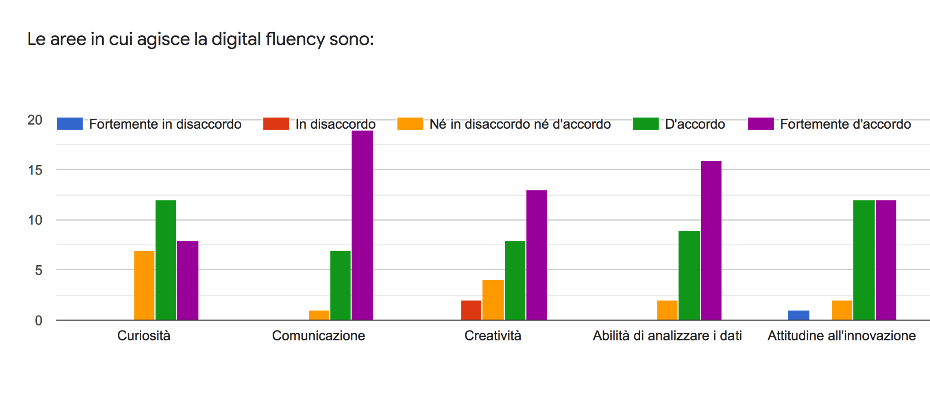
Digital fluency continuum: students gap
DIGITAL FLUENCY: Having the knowledge and strategies to use digital tools and resources effectively to collaborate, communicate, create, network, and inquire.
Students Workshop results in Italy
I think that, in order to do a great research, you need to be open minded about the topic and to carefully analyze what you read and not just copy and paste everything.
Participants:
Engineering and computer science: 23%
Languages and Letters: 28%
Communication and Media: 23%
Education Science 4%
Library 19%
I have an idea, I google it, if I find some nice information, I take it and use it

Slide 6
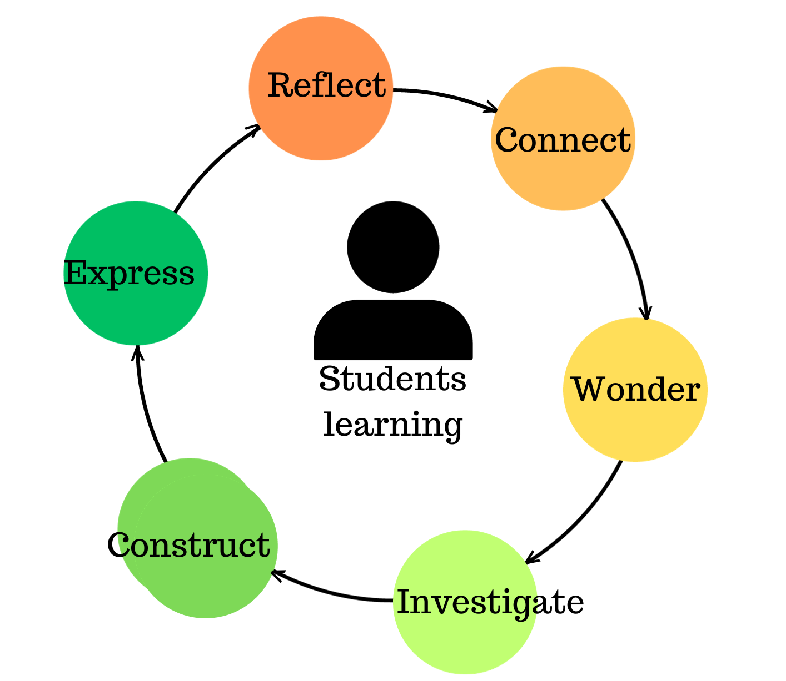
Inquiry cycle
INQUIRY: active independent learning for information fluent learners
Fluent learners take an approach of curiosity, discovery, academic rigor, critical thinking and can create and communicate new understandings
Notes:
Stripling’s Cycle of Inquiry and Learning

Slide 7
Learning outcomes
CONNECT: what you already know and what you do not know
WONDER: identifying questions better guiding investigation
INVESTIGATE: knowing scholarly resources available and use them effectively
CONSTRUCT: building an accurate understanding based on evidence
EXPRESS: making the most compelling case given audience and evidence
REFLECT: self evaluation of your process and your results
Notes:
FOSIL Framework of skills for Inquiry Learning by Barbara Stripling

Slide 8
Curriculum development

Slide 9
CONNECT
CONNECT COMPETENCIES: prior knowledge and knowledge gaps on the research problem
Learning outcomes
Simulation training
Assessment
Background of topic
Brainstorming on knowledge gap
Mind map
Find (3) KW
in research article
Examples
Peer and self formative assessment
Notes:
Reflect on the research problem, what you know, what you do not know and clarify KW

Slide 10
WONDER
WONDER COMPETENCIES: justify research strategy and formulating research questions
Learning outcomes
Simulation training
Assessment
Develop deeper questions by asking “What if?” “Why?” and “So what?” Examples
Make hyphotheses, identify methods, ask rich questions
Peer assessment
Procrastination...

Slide 11
INVESTIGATE
INVESTIGATE COMPETENCIES: finding and evaluating information and data
Learning outcomes
Simulation training
Assessment
Collecting data from different sources and experiments
Evaluate how information and data answer to questions
Literature review (5 most important references)
Citation style
Examples
Peer formative assessment
Teachers prepare templates

Slide 12
CONSTRUCT
CONSTRUCT COMPETENCIES: make meaning and build new understandings
Learning outcomes
Simulation training
Assessment
Construct new understandings
Draw conclusions on questions
Prepare a structured abstract (250 words)
Plagiarism
Self assessment
Teacher’s questions

Slide 13
EXPRESS
EXPRESS COMPETENCIES: communicate the found evidence to target audience
Learning outcomes
Simulation training
Assessment
Express new ideas and share learning
Revised outline of research proposal and its significance
Self and Peer assessment
Proving marking rubric so students

Slide 14
REFLECT
REFLECT COMPETENCIES: evaluating how you have worked and your results
Learning outcomes
Simulation training
Assessment
Reflection on the Inquiry process
New questions
Teachers prepare checklist
Self assessment

Slide 15
Conclusion
Focus on the Information-Fluent Learner!
Inquiry based learning integrates:
transliteracy practices with the STEAM approach
transliteracy practices with the game based model at conceptual level

